Slide 1
Gun Violence in America
Team 7
Members : Amrita Kohli, Charu Shekhar, Rasna Husain

Slide 2
Tasks
Amrita - Main, Testing and documentation, Data structure Diagram,
Charu - Hashing algorithm, Structure chart, Read File
Rasna - BST algorithm, UML Diagram, Text file and powerpoint presentation
Everyone collaborated on everything

Slide 3
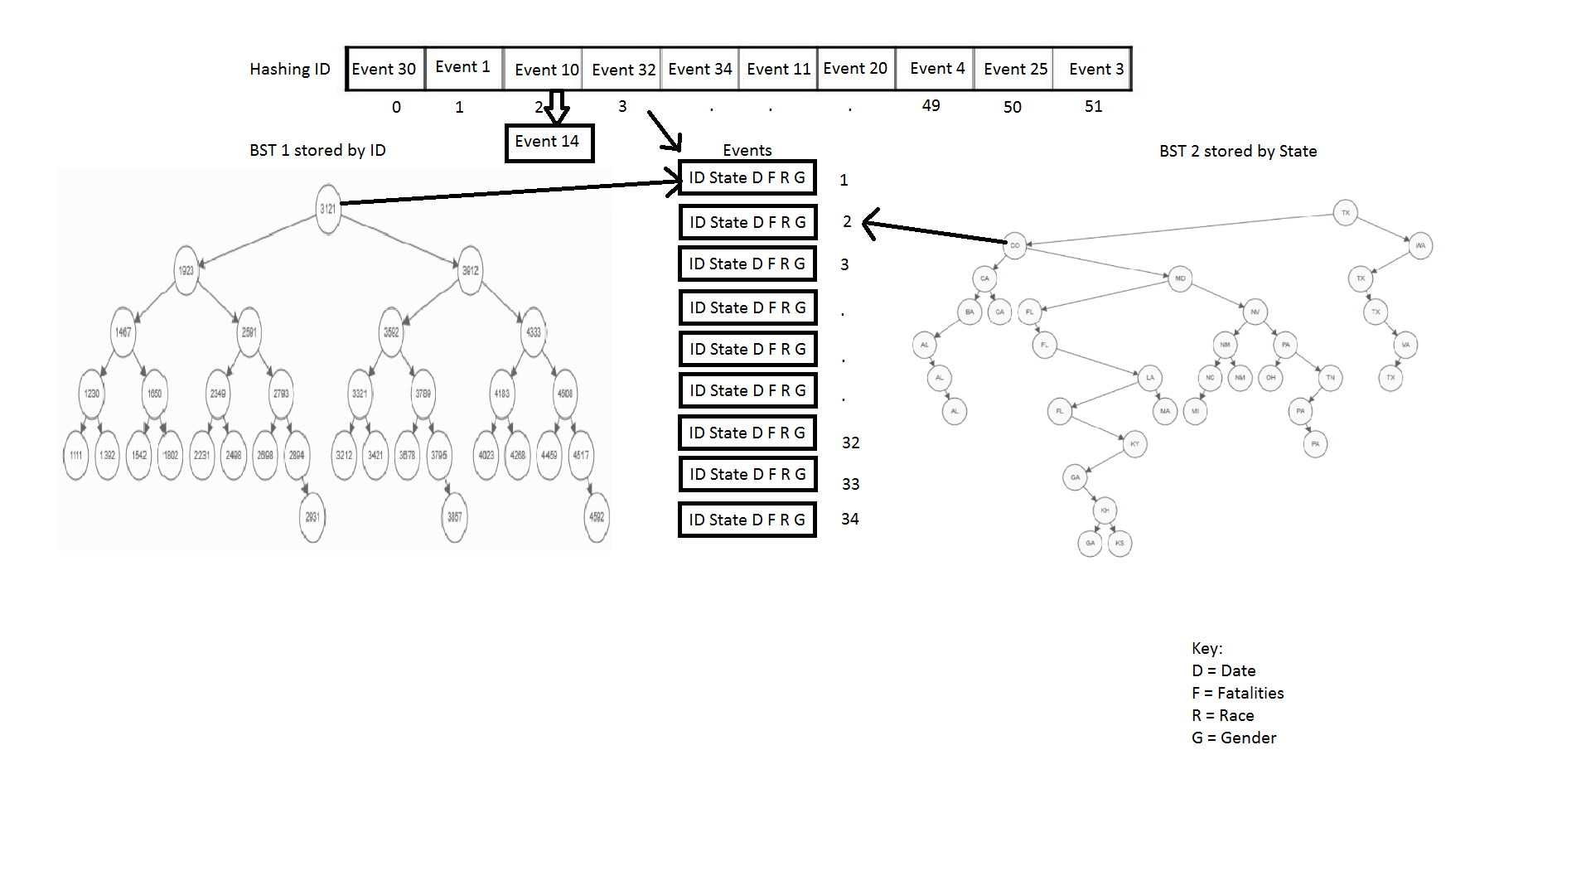
Data Structure Diagram

Slide 4
Sort
Balanced tree using a program

Slide 5
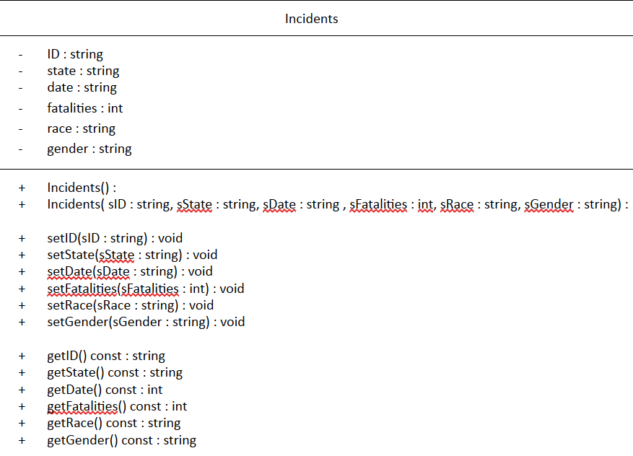
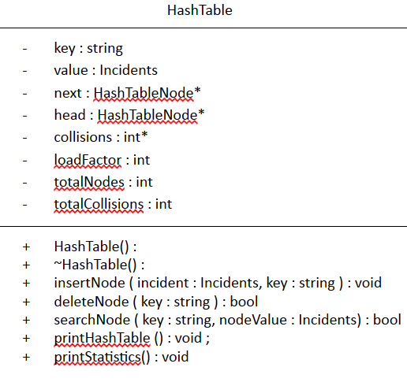
UML diagrams

Slide 6
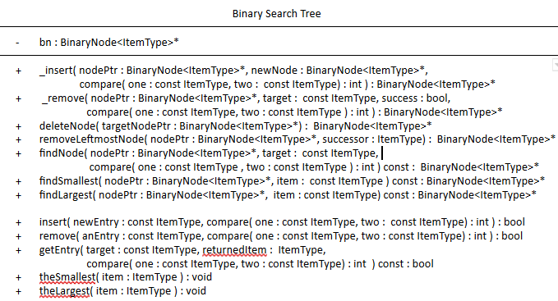
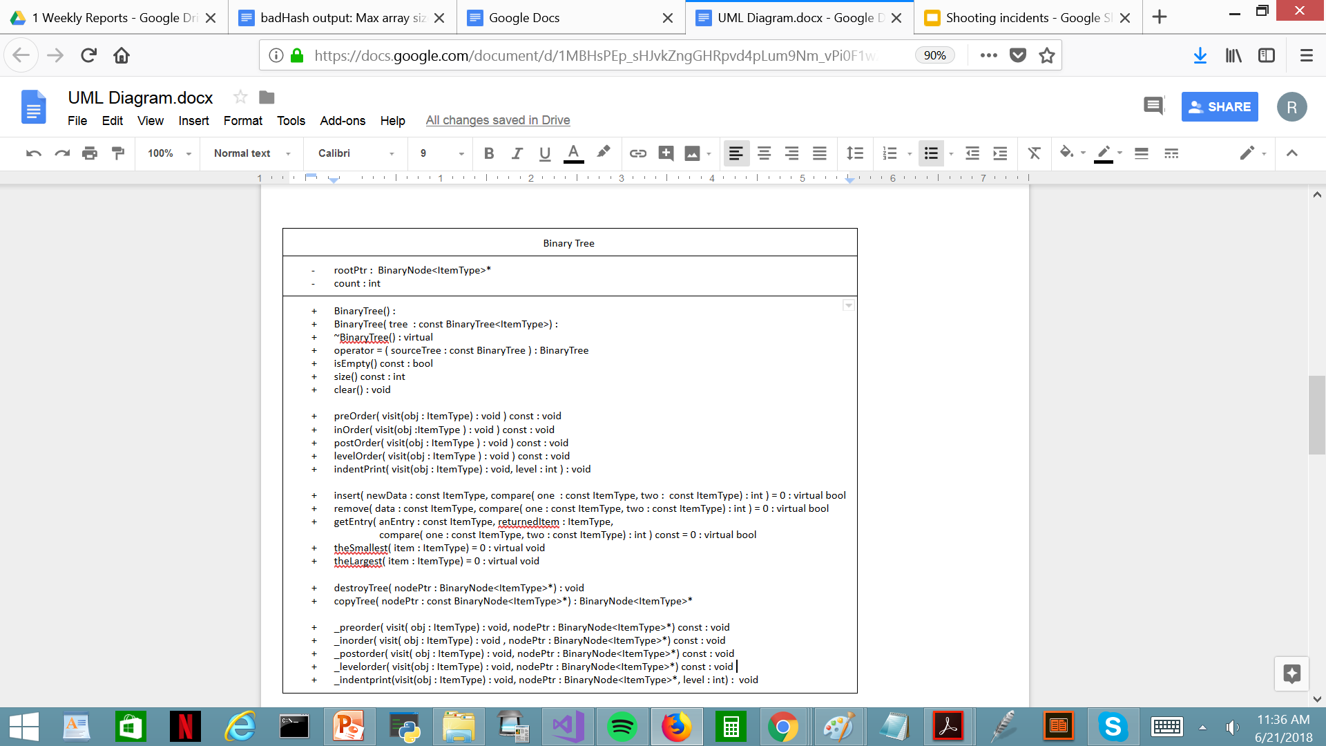
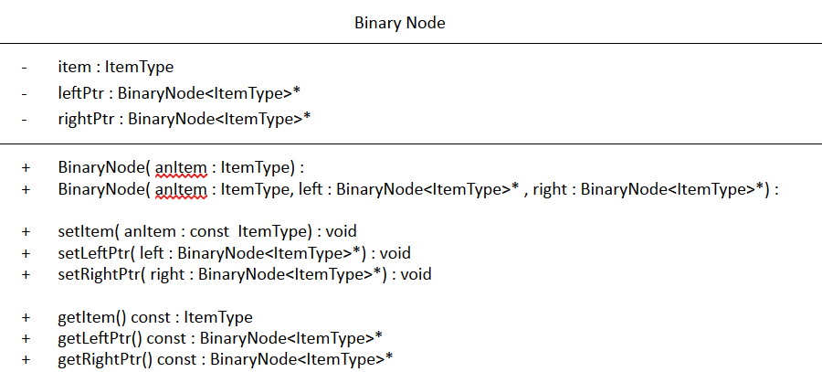

Slide 7
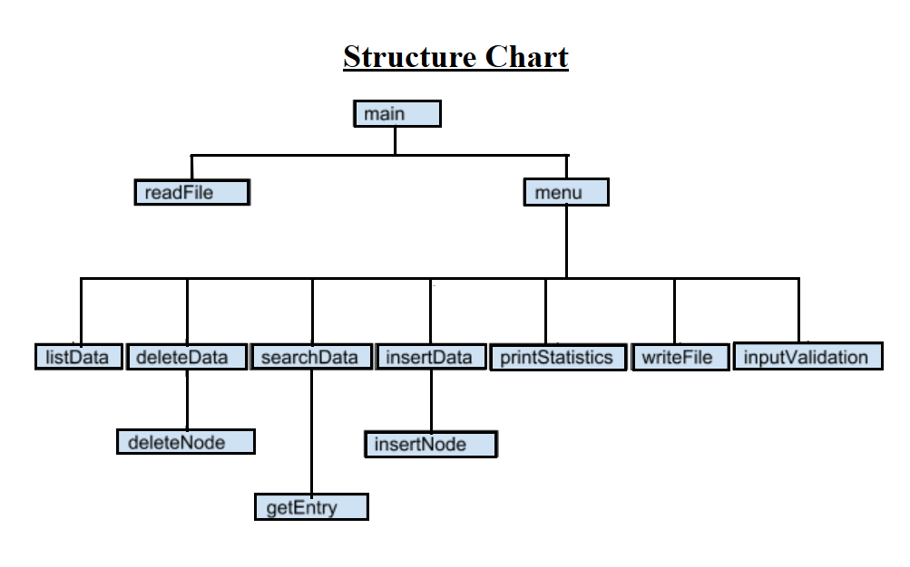
Structure charts

Slide 8
Hash function
Input : string
hash : int
linked -list collision resolution method
Max no of collisions = 2
Load factor is more than 50%

Slide 9
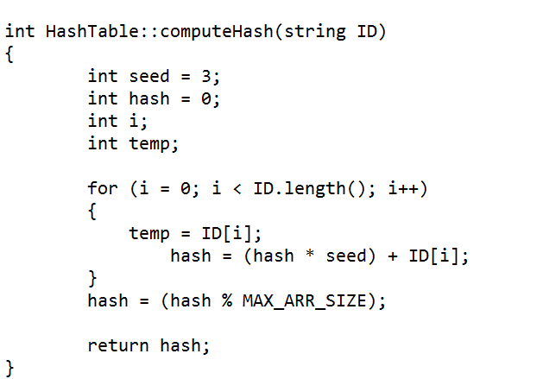
goodHash

Slide 10
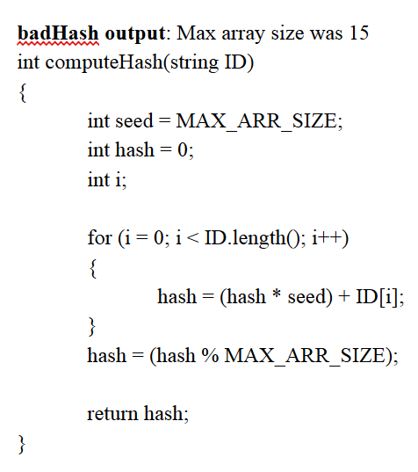
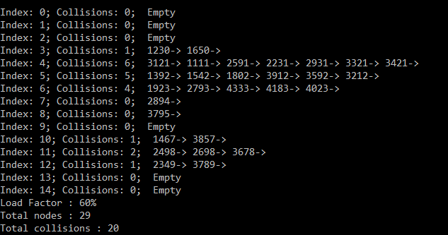
badHash

Slide 11
Questions?

